Slide 1
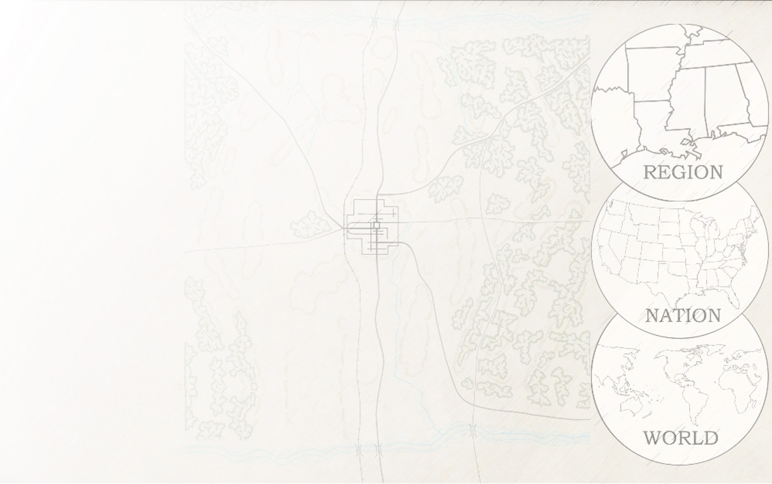


The Bitter Sum: Accounting for Racist Words in
Absalom, Absalom!
Johannes Burgers
Assistant Professor of Digital Humanities and English, Ashoka University, New Delhi
Associate Director, Digital Yoknapatawpha
The University of Virginia

Slide 2
Overview
Methodology
Statistical Overview
Sentiment Analysis
Character, Time, and Location Frequency analysis; or three ways of saying Thomas Sutpen

Slide 3
Thesis
A statistical overview of Absalom, Absalom! suggests that the use of the n-word is the most ubiquitous around Thomas Sutpen.
In particular, it the events where the n-word is used the most are those surrounding his origin story in Tidewater, VA in the 1830s.

Slide 4
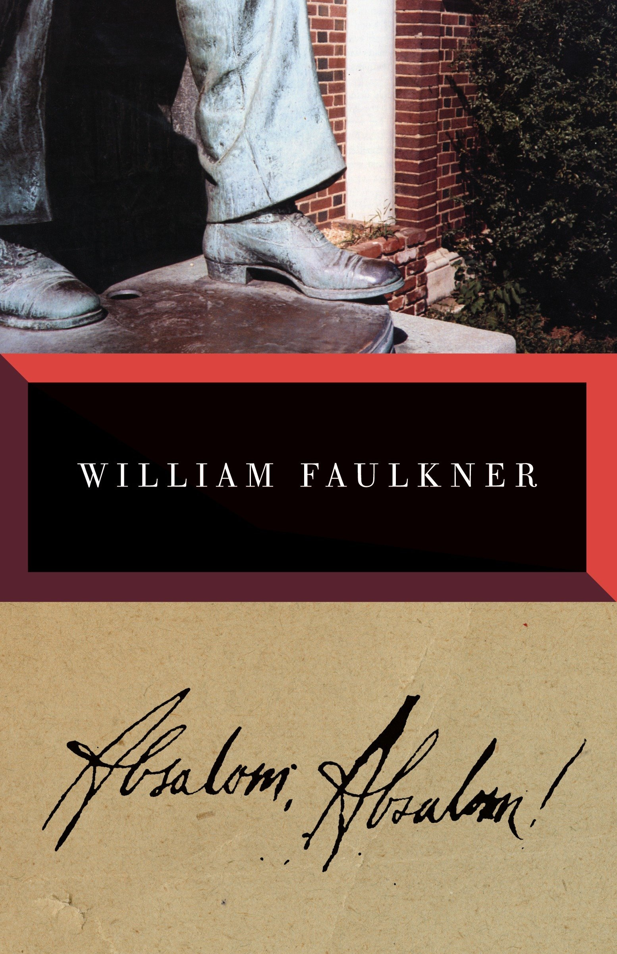
Methodology
Corpus Linguistics
Statistical Analysis of the word-use in a text

Slide 5
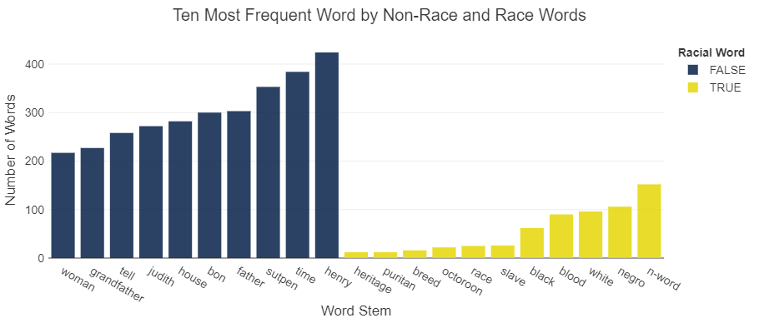
Word Frequency

Slide 6
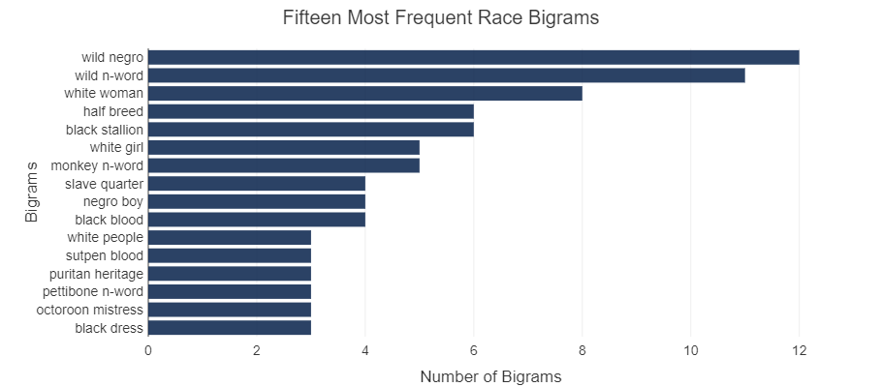
Bigram Frequency

Slide 7
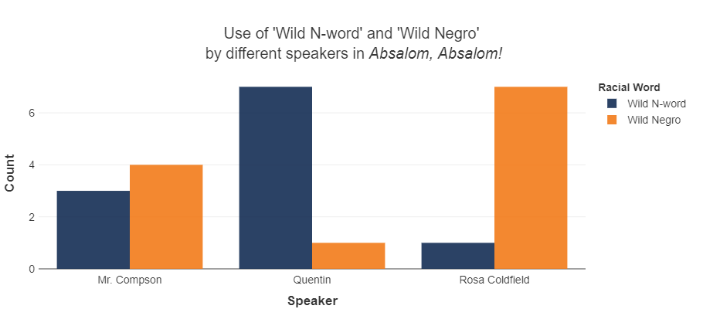
Comparative Use of Race Words
Use of ‘Wild Negro’ versus ‘Wild N-word’

Slide 8
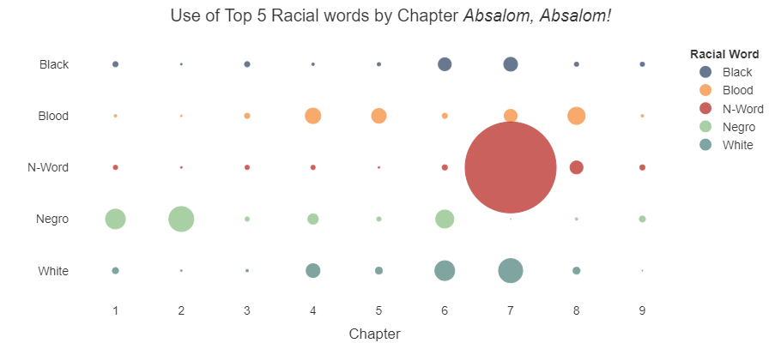
Comparative Use of Race Words
Across the text

Slide 9
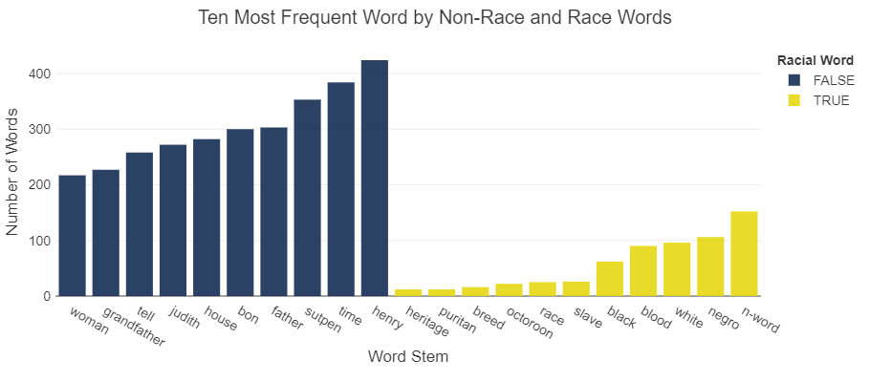
Advanced Methodology

Slide 10
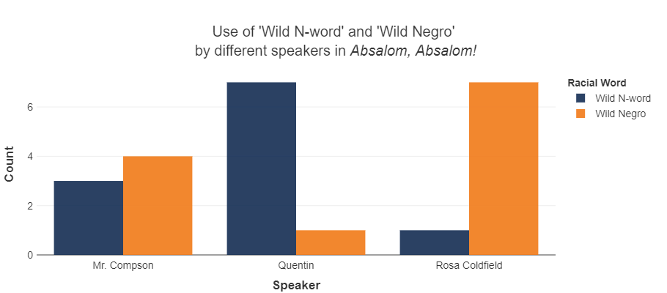
Sentiment of Race Words

Slide 11
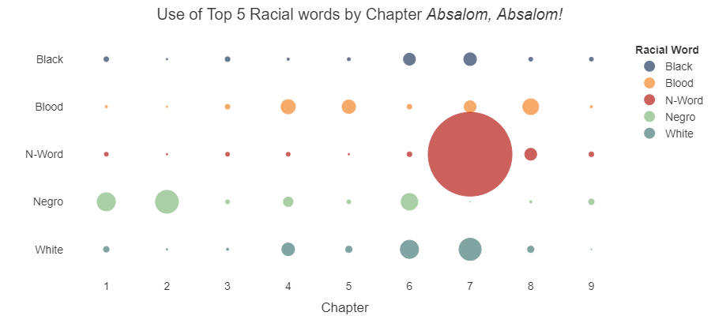
Frequency by Character

Slide 12

Use of N-word in terms of
Presence of Characters

Slide 13
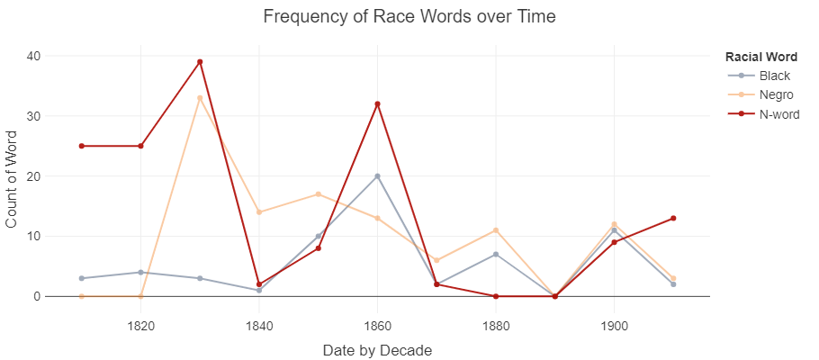
Use of N-word in terms of
Time Period

Slide 14
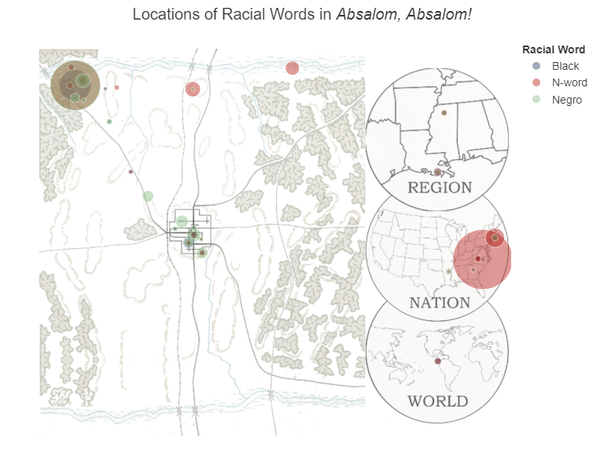
Use of N-word in terms of
Locations

